Slide 1

International Patient Treatment
Management System
Presented by :-
Satwik Yadav ( 908878)
Visarika Vaidya ( 907095)
Samruthashreevarshini R (907271)
Kesa Jagadish (911121)

Slide 2
Project Overview
A leading hospital wants to bring up a web application to list and choose the treatment packages for International patients, register them, track their treatment to closure thru insurance claim.

Slide 3

Aims & Objectives
To make a portal for international patient treatment system for hospitals.
Portal having functionalities like:
View Treatment Services.
New Patient Registration and display treatment plan.
View Insurer Details
View final amount to be paid.

Slide 4

Requirements
REQ_01
International patient treatment offerings module
REQ_02
International patient treatment module
REQ_03
Insurance claim module
REQ_04
Authorization service
REQ_05
International patients treatment management portal

Slide 5

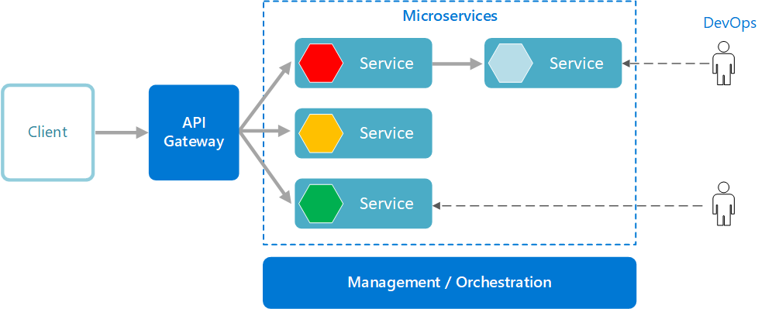
System Architecture Design

Slide 6

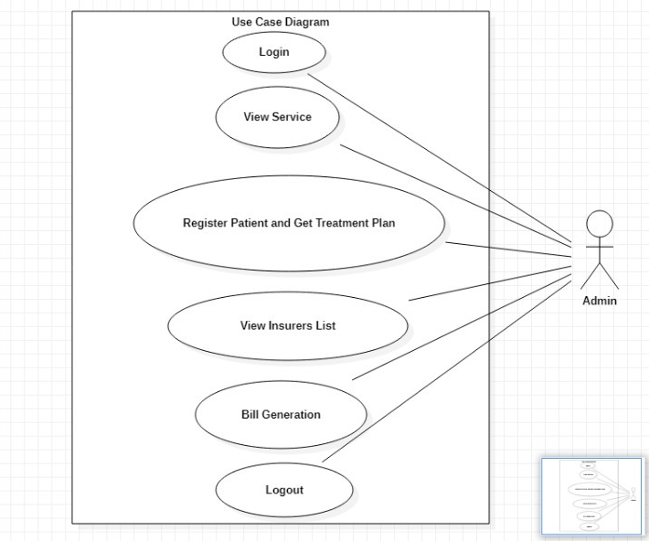
USE CASE DIAGRAM

Slide 7

Technical Requirements
Hardware Requirement:
Developer Desktop PC with 8GB RAM
Software Requirement
Visual studio 2019 enterprise edition
Postman Client in Chrome
Azure cloud access

Slide 8

Microservices
International patients treatment management portal
Authorization service
International patient treatment offerings
International patient treatment
Insurance claim

Slide 9
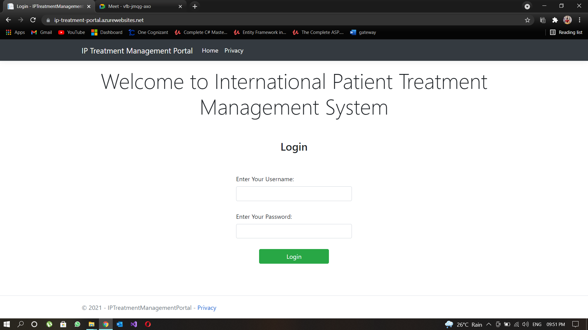
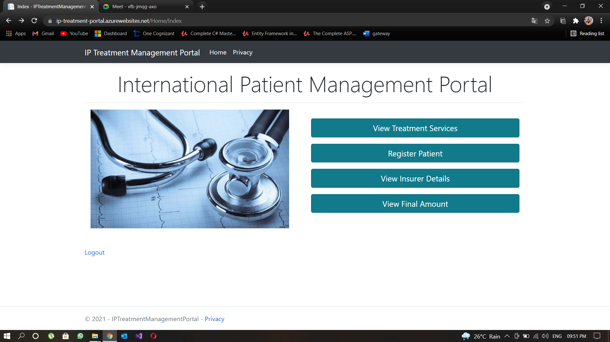
International Patients Treatment Management Portal

Slide 10
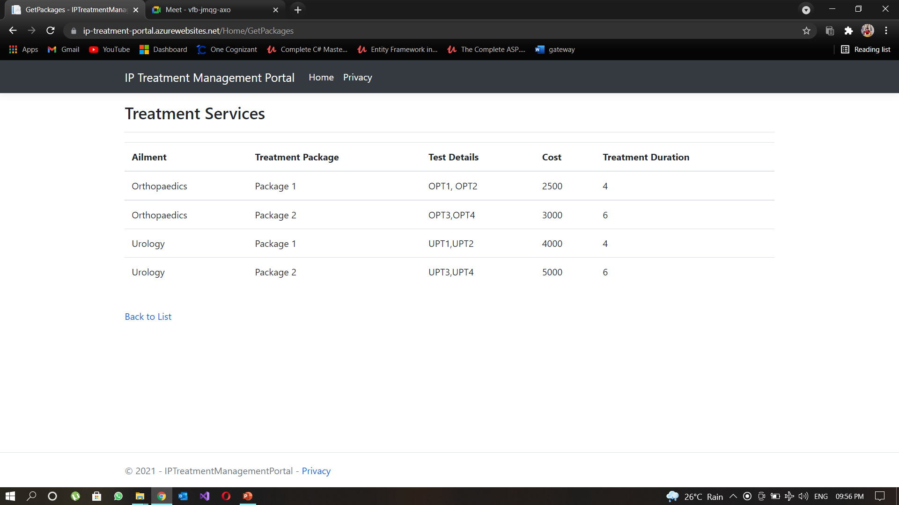
Treatment Services Offered

Slide 11
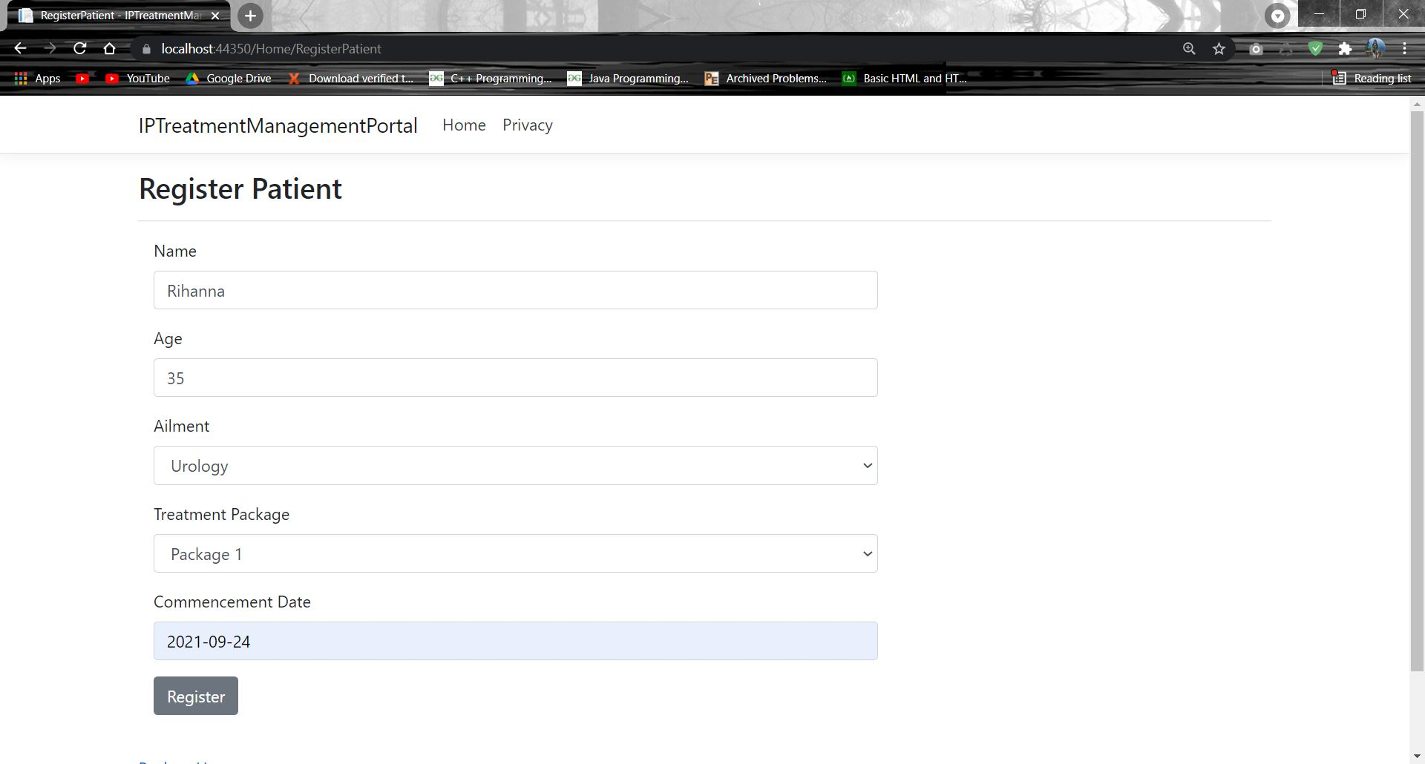
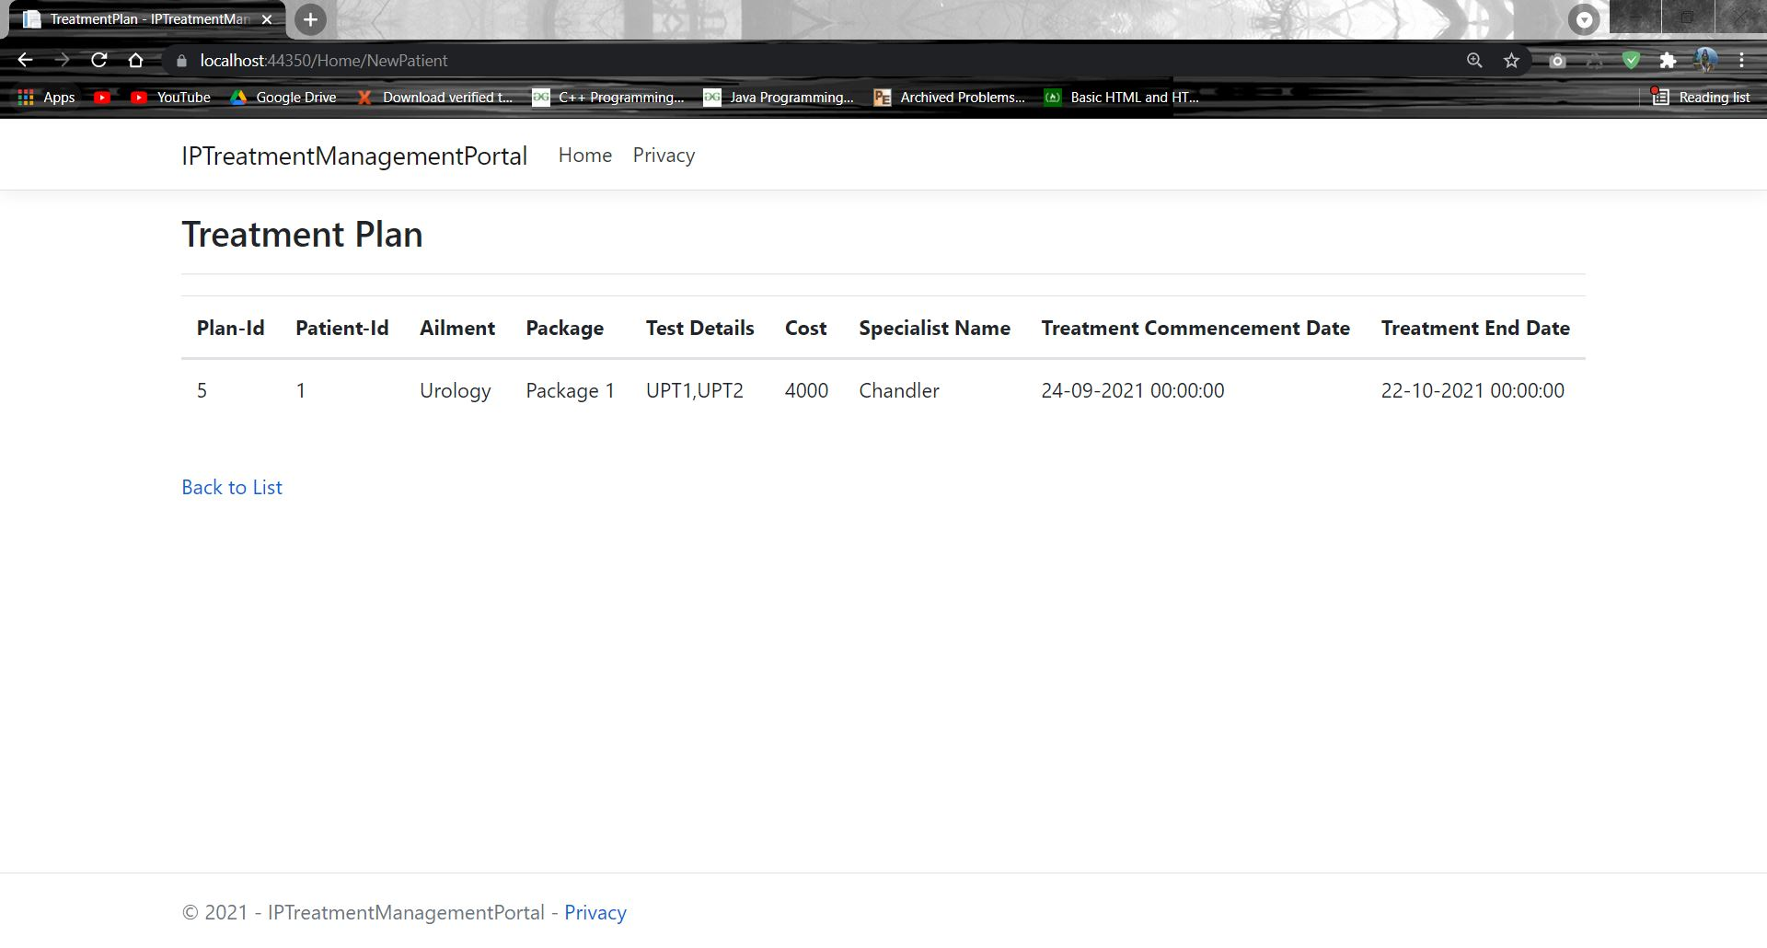
Registration And Treatment Plan Offered

Slide 12
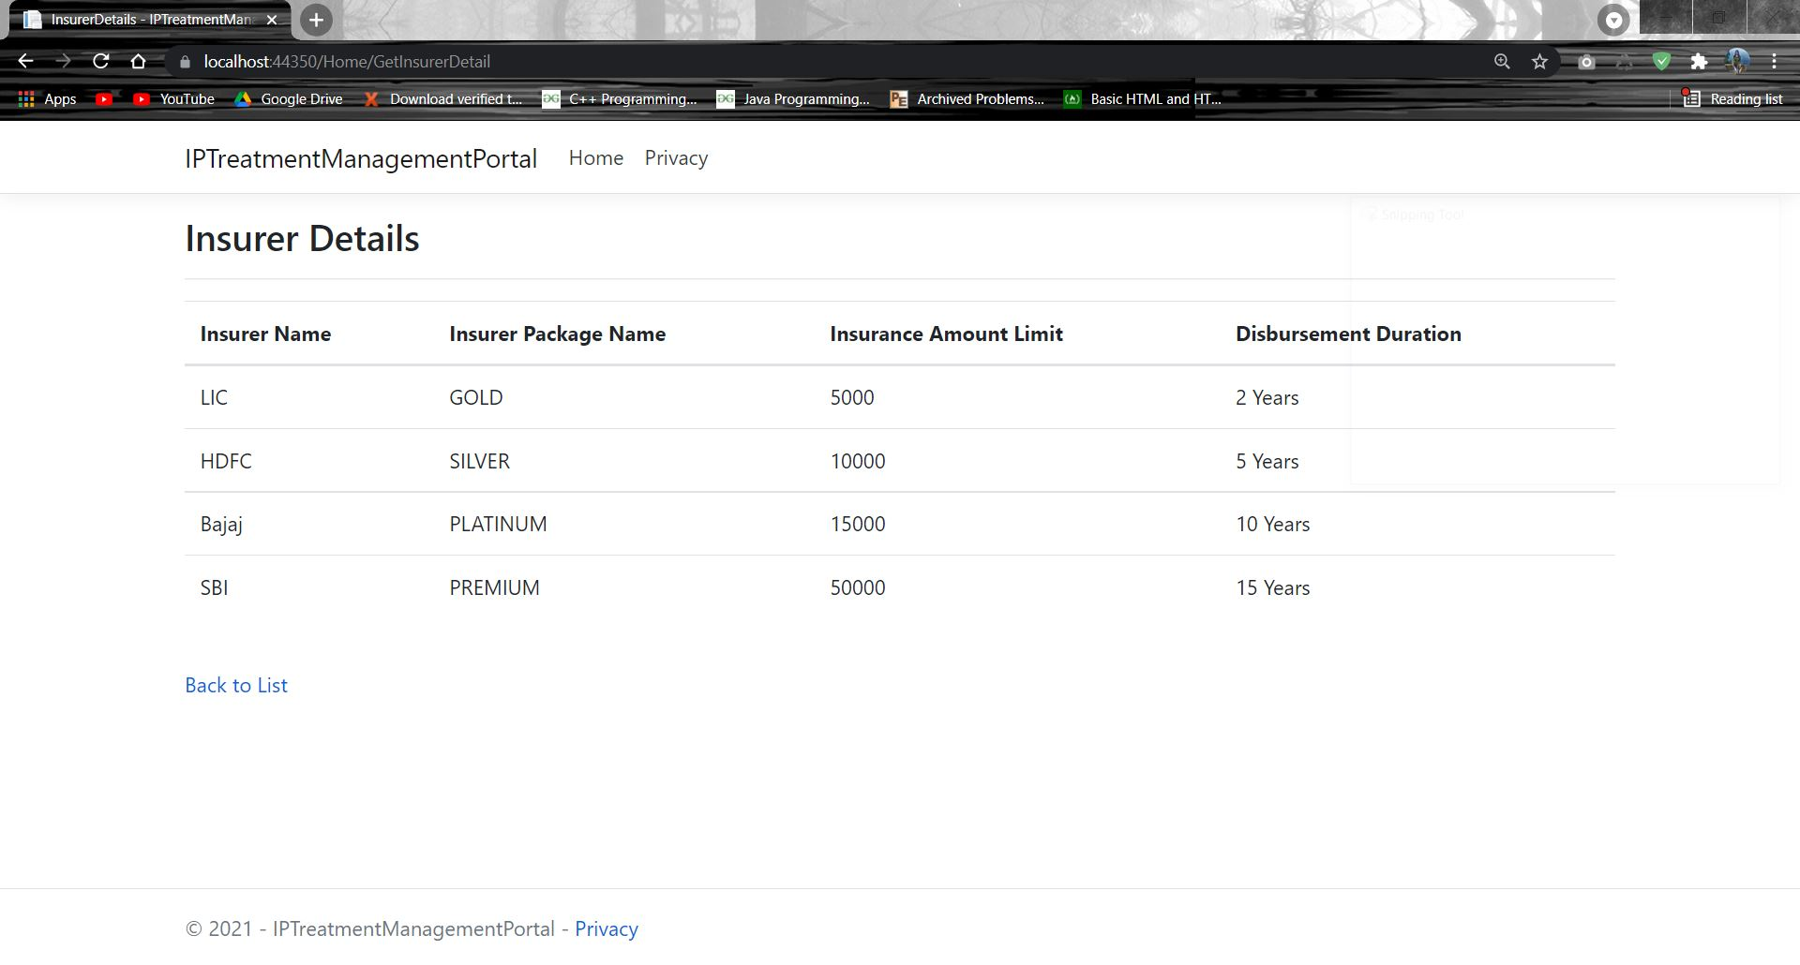
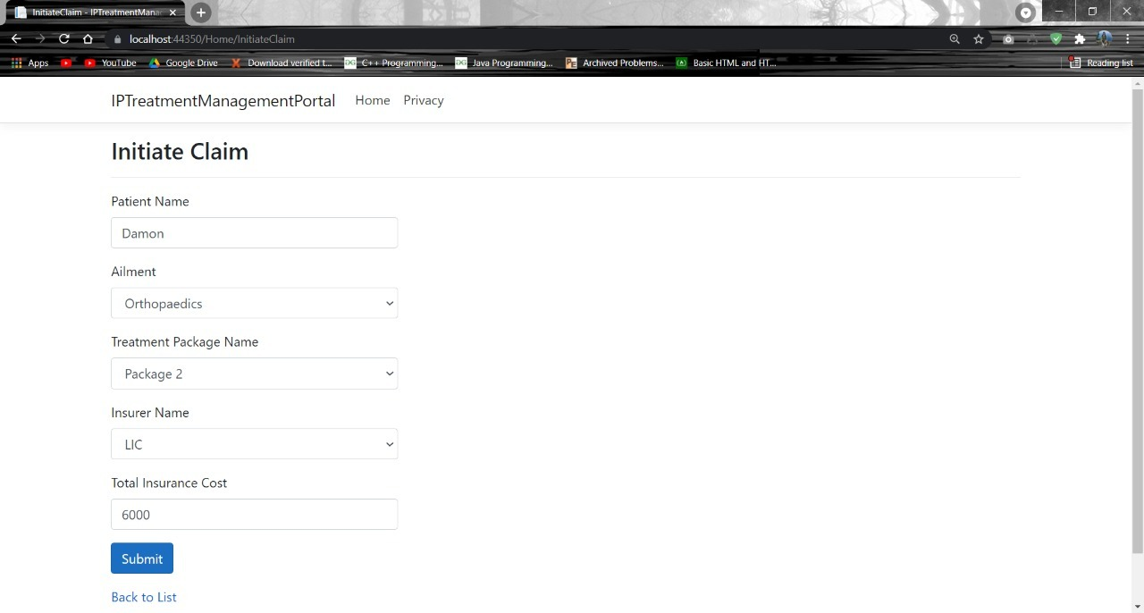
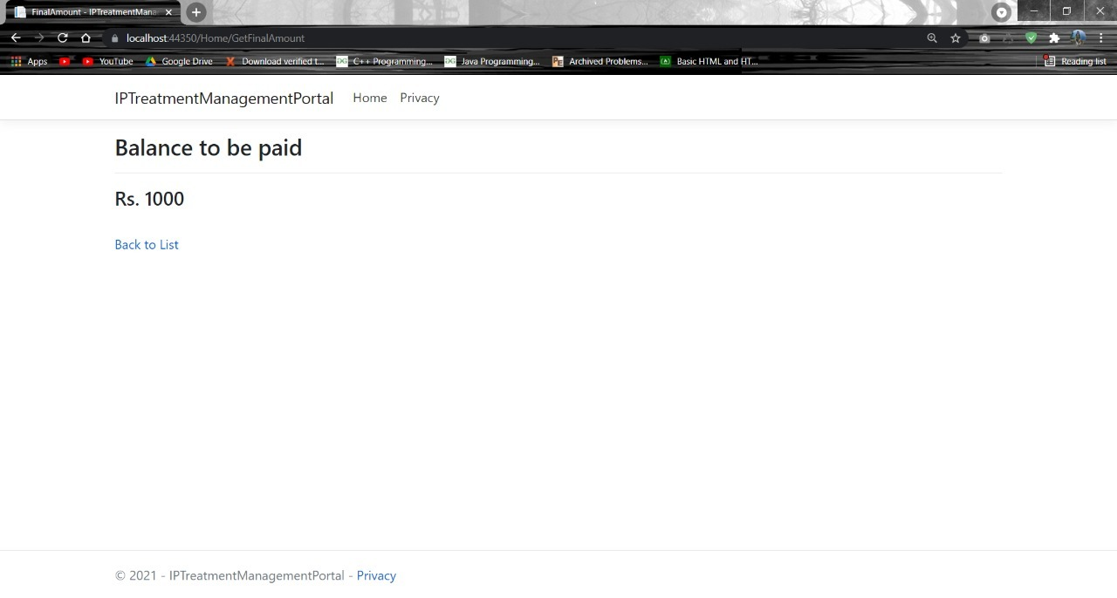
Insurance Claim Process

Slide 13
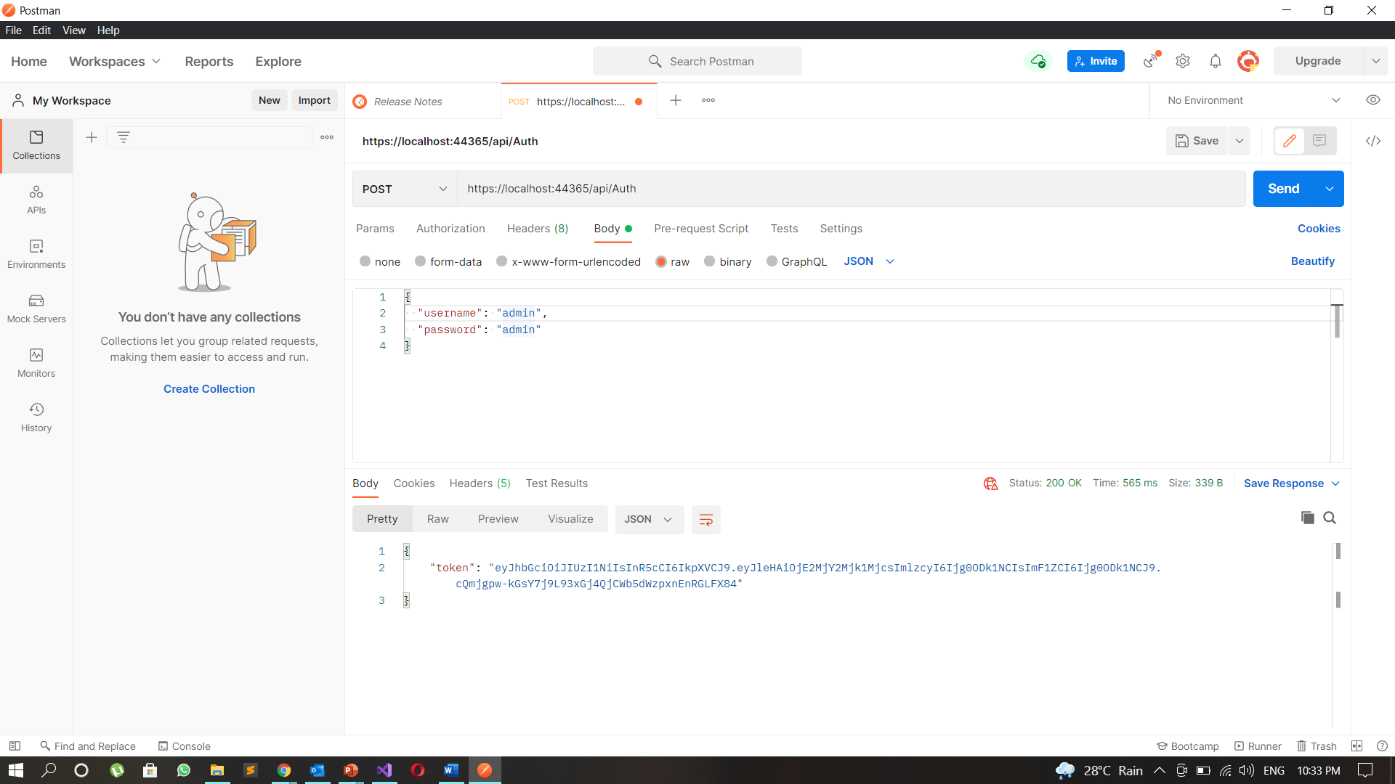
POSTMAN DEMONSTRATION
Authorization service

Slide 14
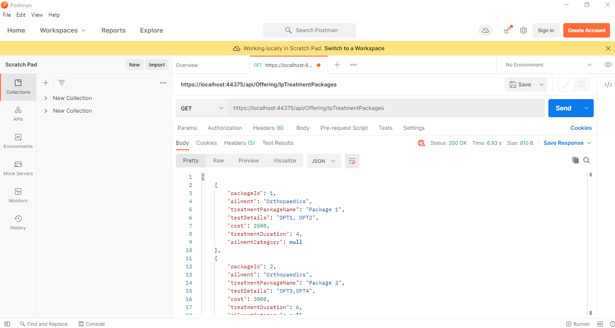
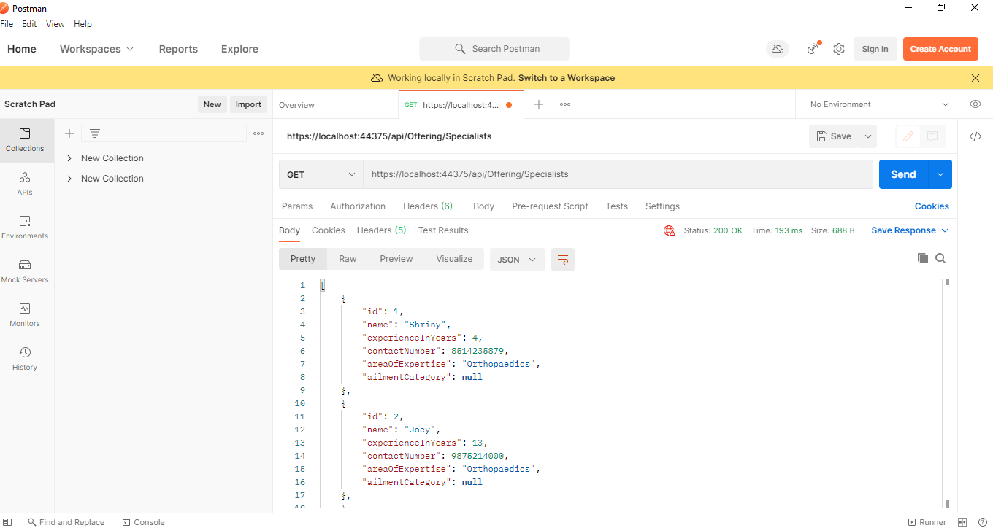
International Patient Treatment Offerings Microservice

Slide 15
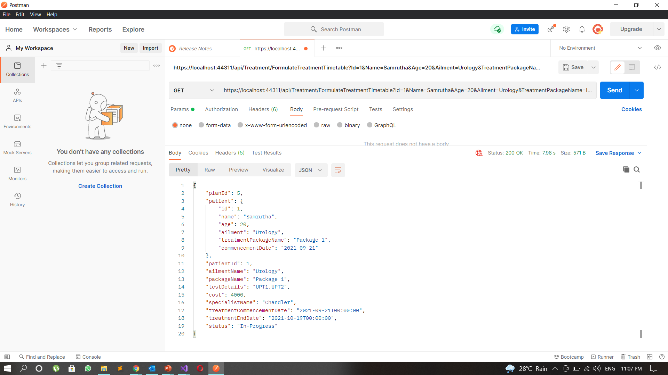
International Patient Treatment Microservice

Slide 16
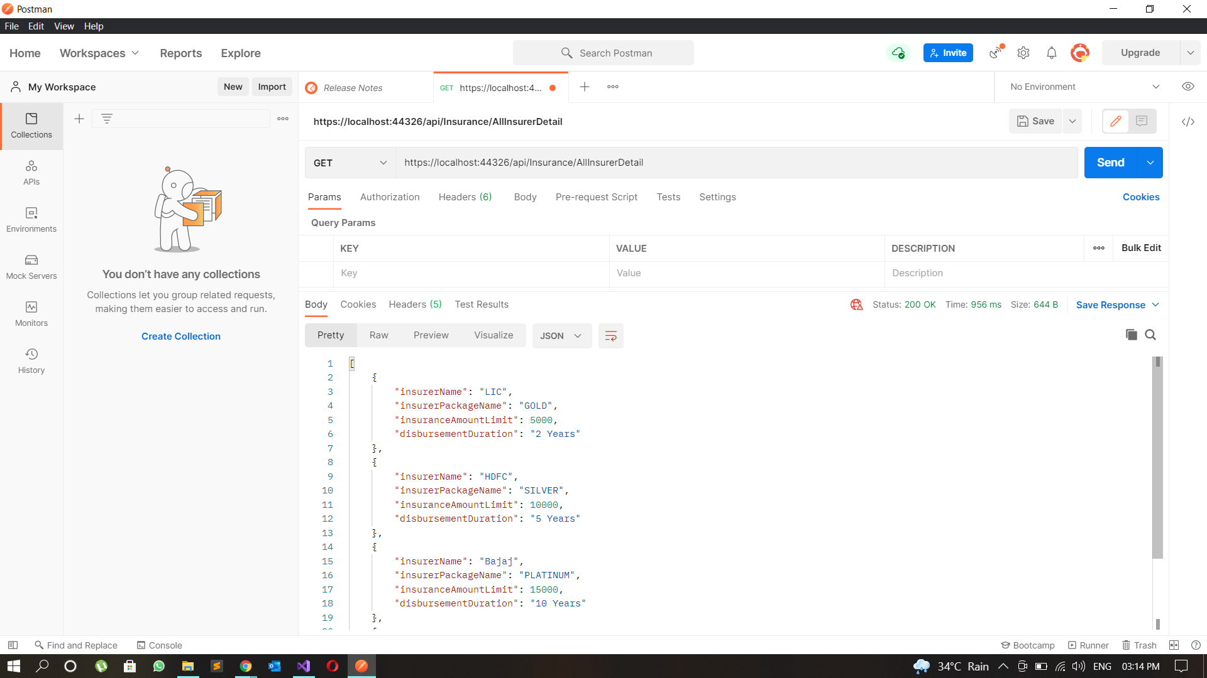
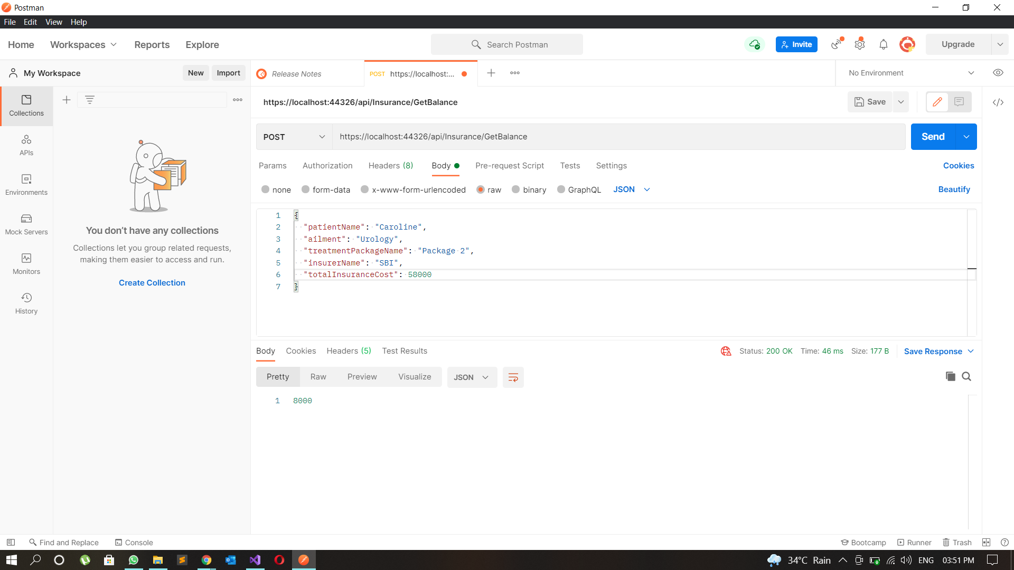
Insurance Claim Microservice

Slide 17
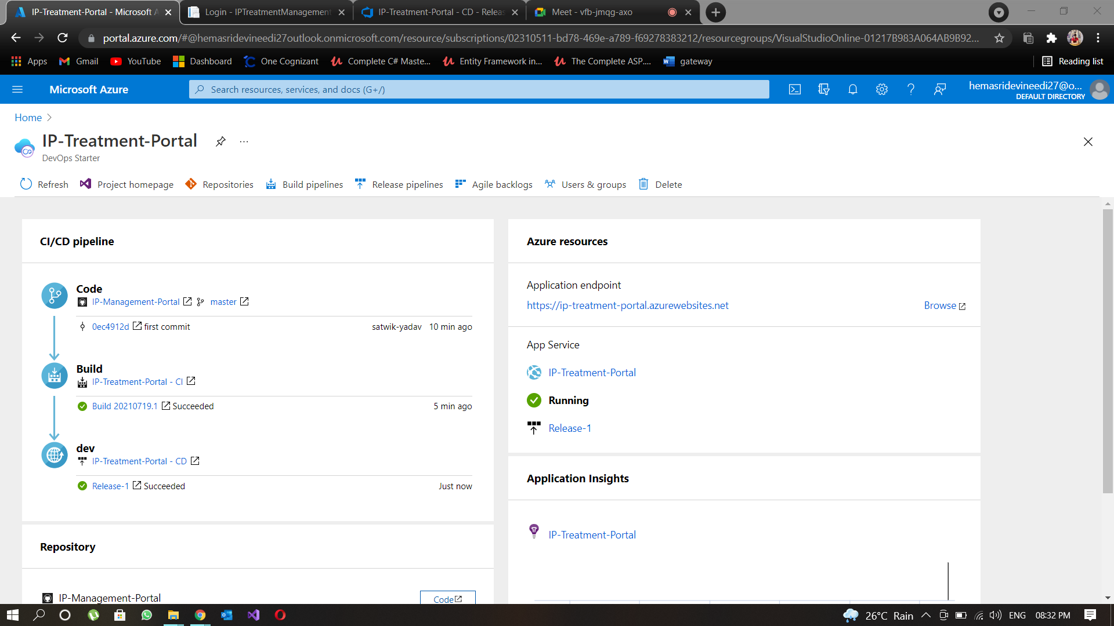
CLOUD DEPLOYMENT
International patient treatment management portal

Slide 18
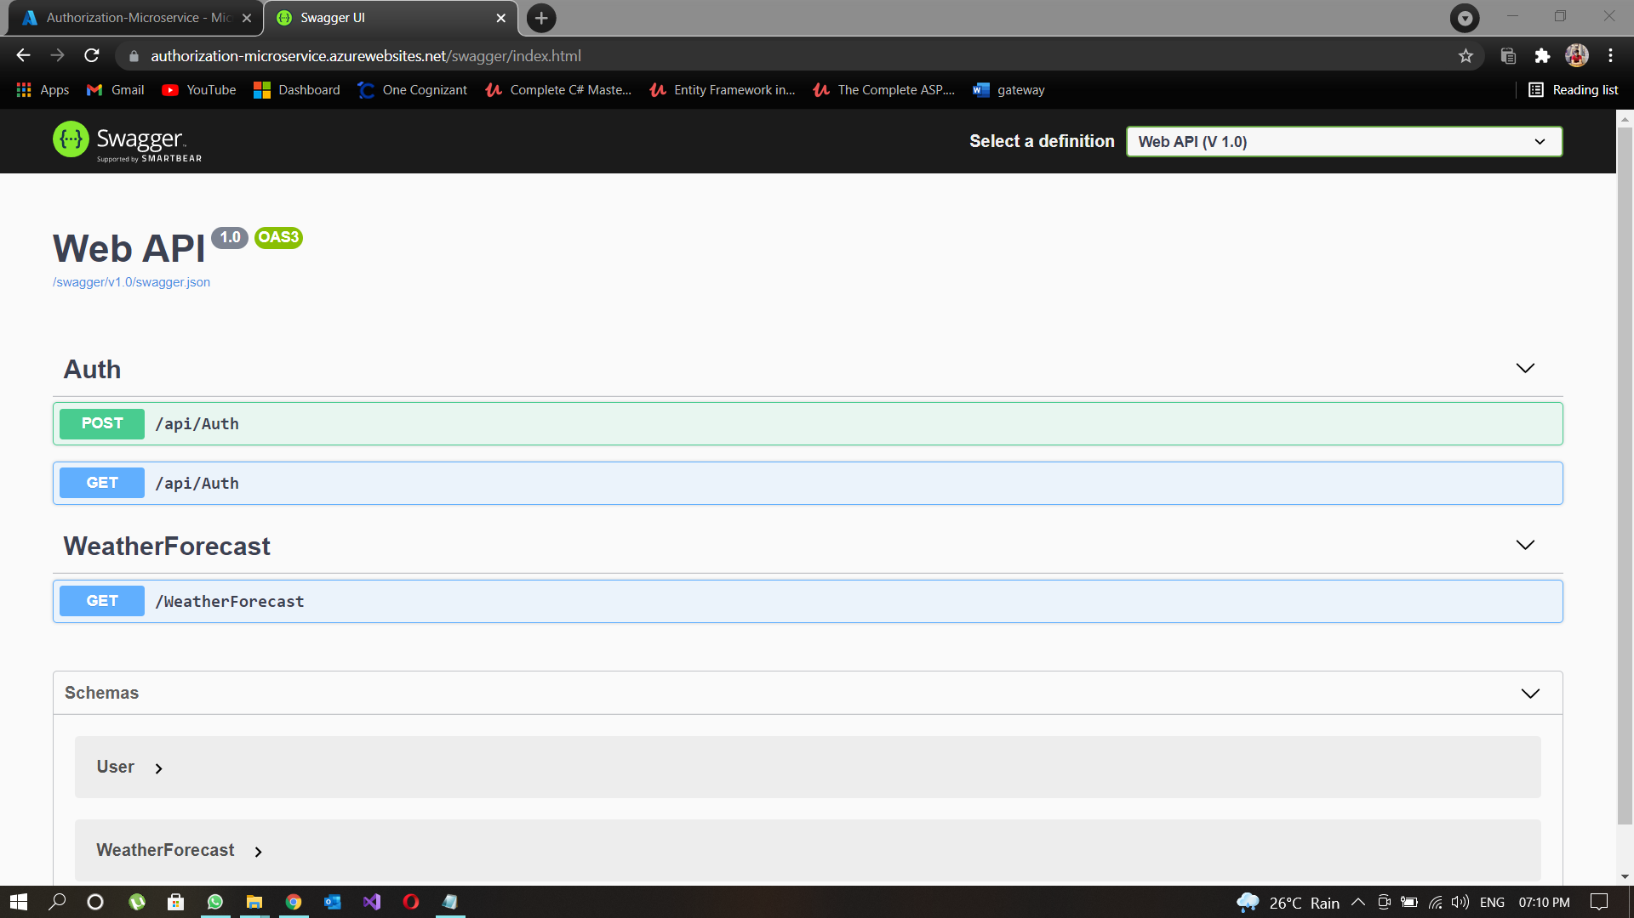
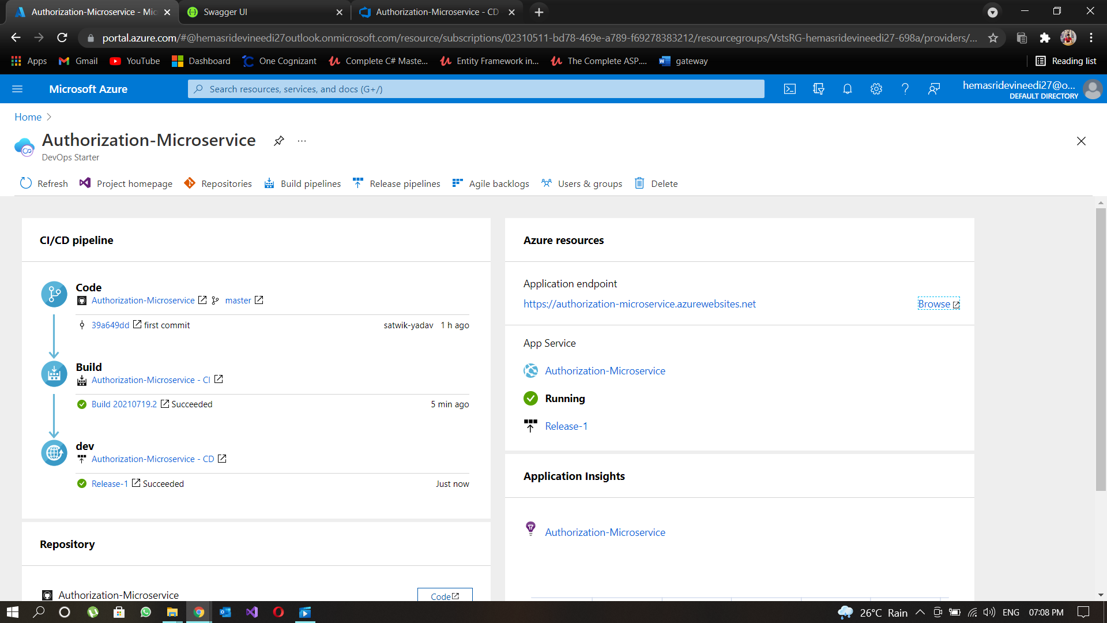
Authorization service

Slide 19
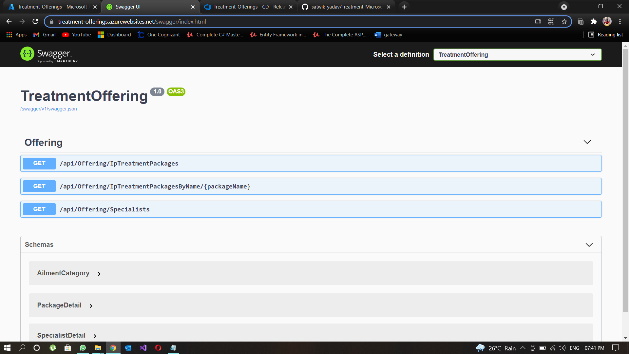
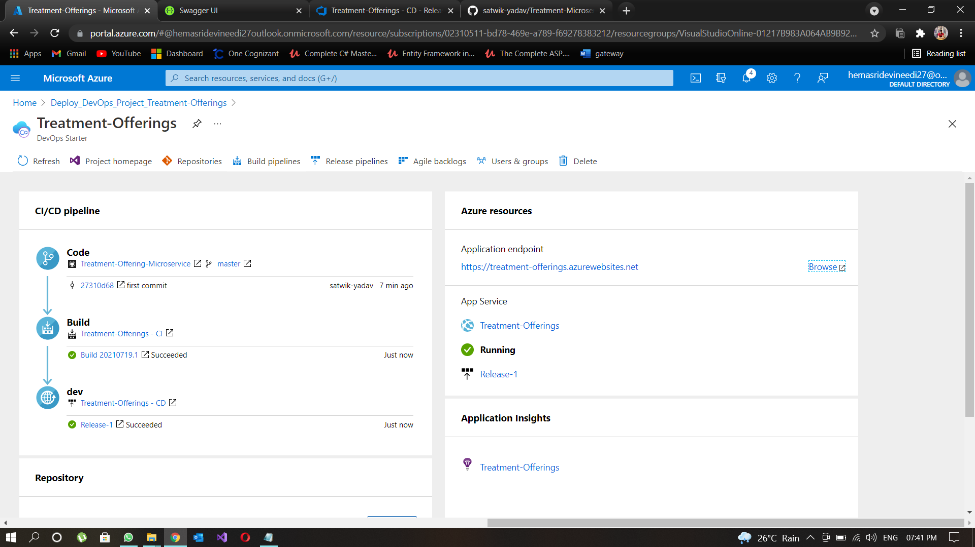
Treatment Offerings Service

Slide 20
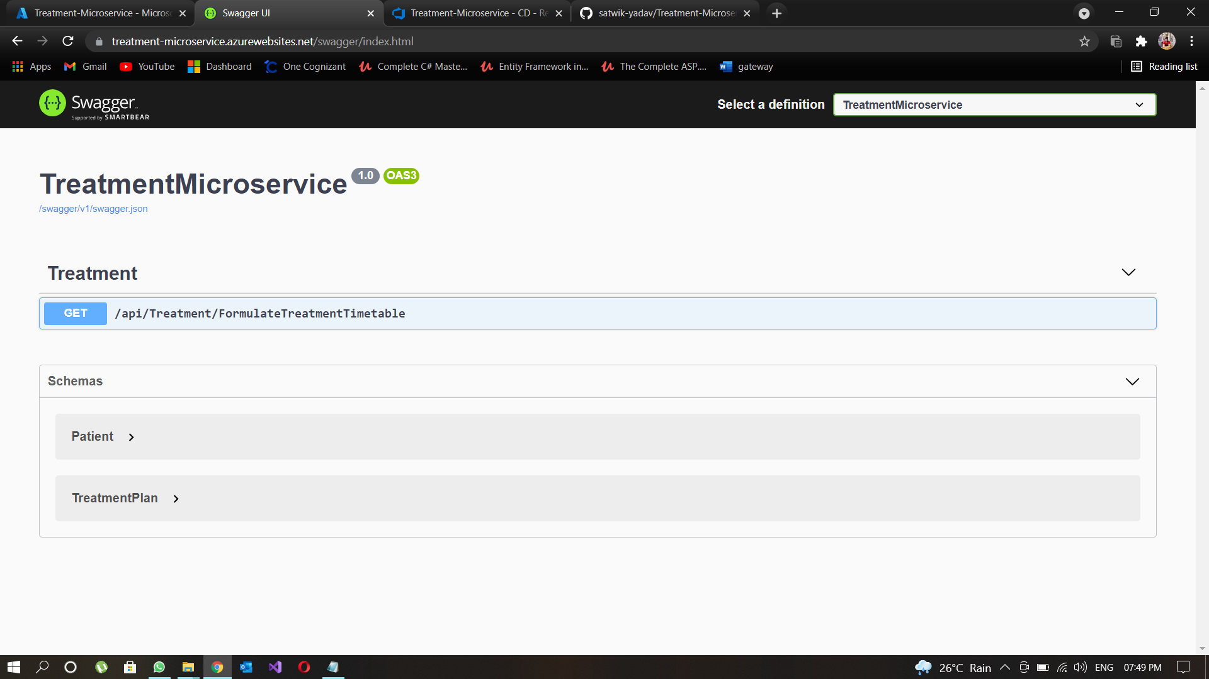
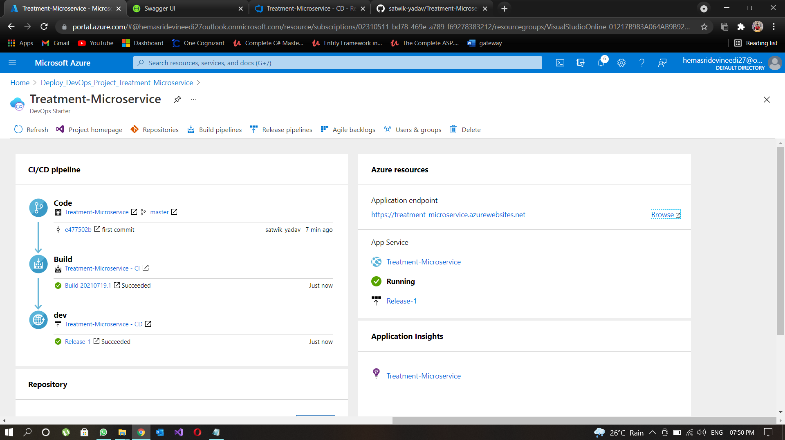
Treatment Microservice

Slide 21
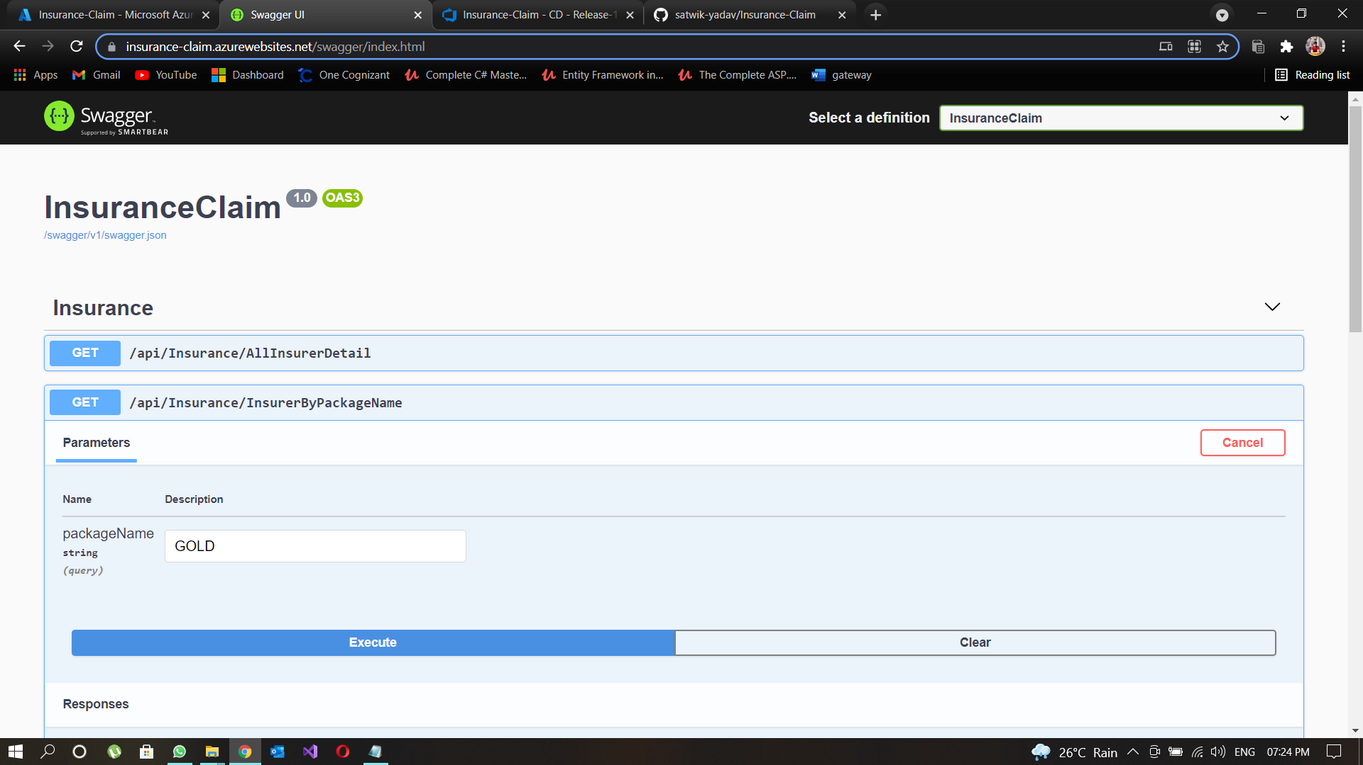
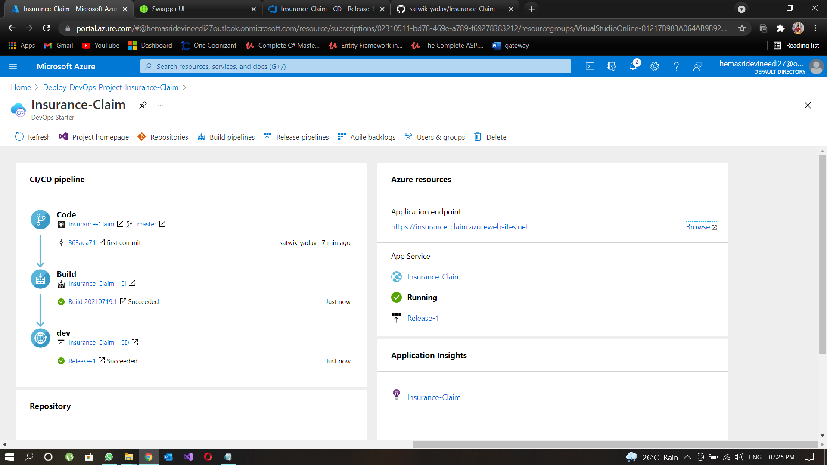
Insurance Claim Service
Insurance Claim Service

Slide 22

WE AT COGNIZANT AIMS AT DELIVERING THE BEST SOLUTIONS TO THE WORLD UNDER THE GUIDANCE OF WORLD CLASS MENTORS.

